Slide 1


Slide 2
Employees can………….
Apply for Annual Leave, Alternative Leave, Sick Leave, Bereavement Leave & Unpaid Leave
View and Print Payslips
View Contact Information
View Annual Leave , Alternative Leave & Sick Leave Balances
Delete Leave Requests
Managers can……..
Apply for Annual Leave, Alternative Leave, Sick Leave, Bereavement Leave & Unpaid Leave
View and Print payslips
Accept Leave requests, Decline Leave requests & Delete Leave requests
View Payroll Reports
View Contact Information

Slide 3
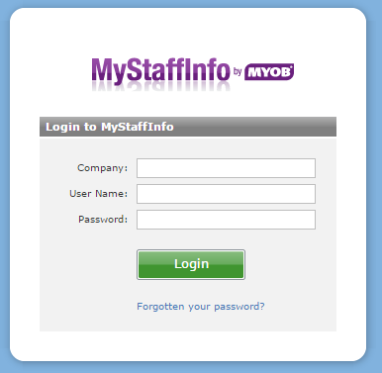
www.mystaffinfo.myob.com
Telnet : 219074
CCP: 219072
Email address your pay slip is sent to
You can change your password by clicking on the forgotten password link. It will send you an email ( The one you log in with) from there you will click on the link and follow the instructions to change your password
Date of Birth
dd/mm/yyyy

Slide 4
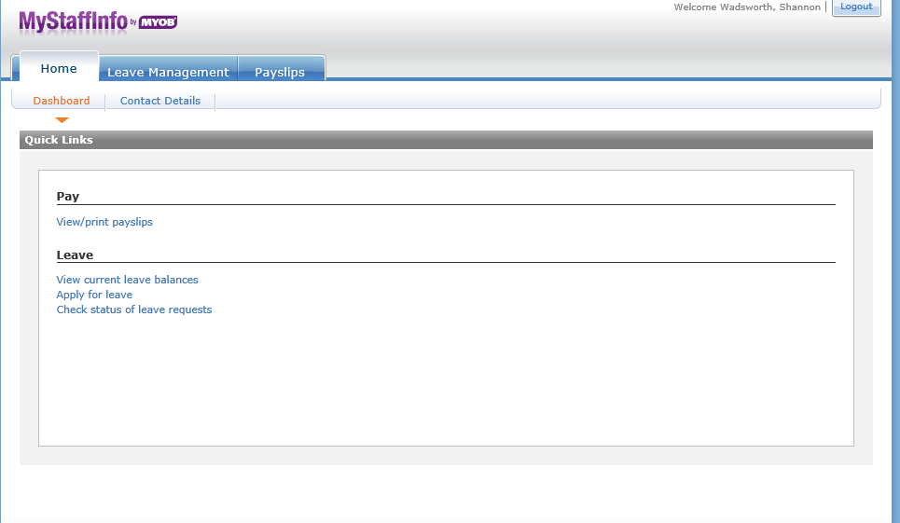
Once you have logged in…….
Quick Links will take you through

Slide 5
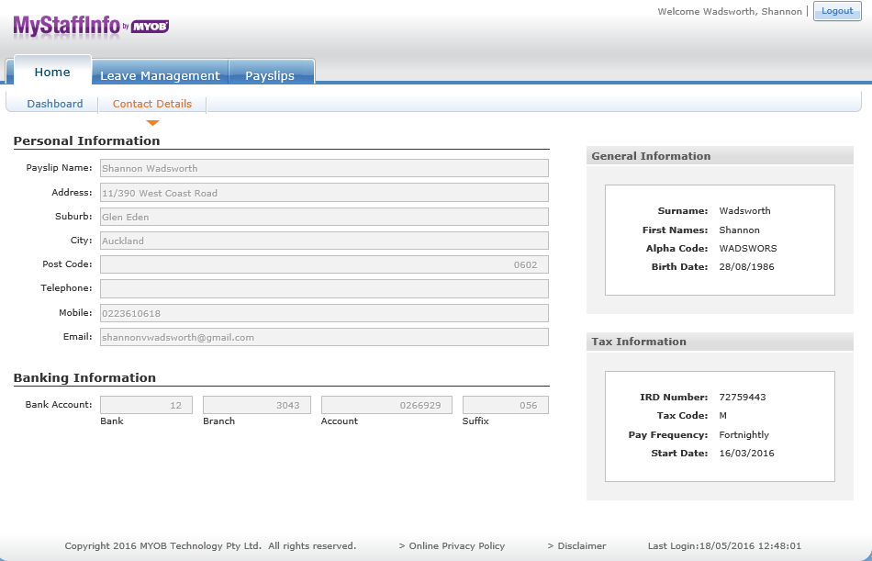
131 Queen Street
022 222 2222
shannon.Wadsworth@telnet.nz
555-555-555

Slide 6
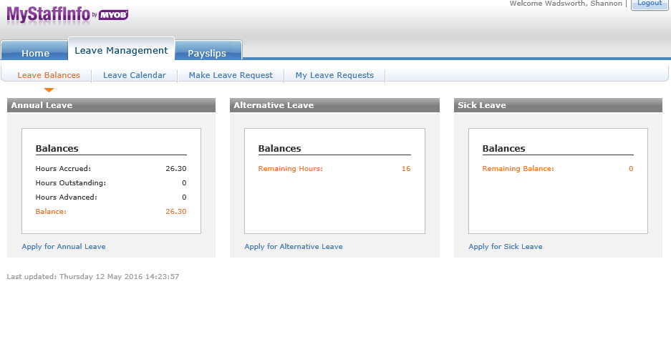
Sick Leave is displayed in Days
Balance = Leave they can take
Clicking on link will take you to the applying for leave section

Slide 7
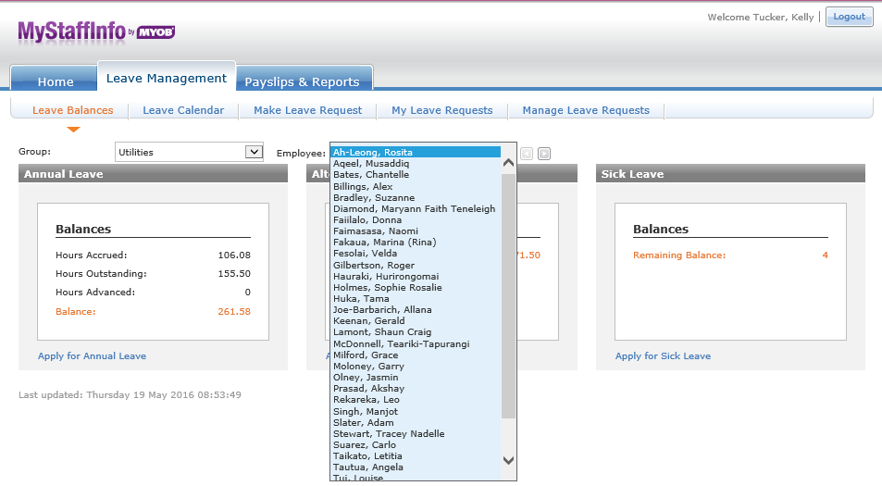
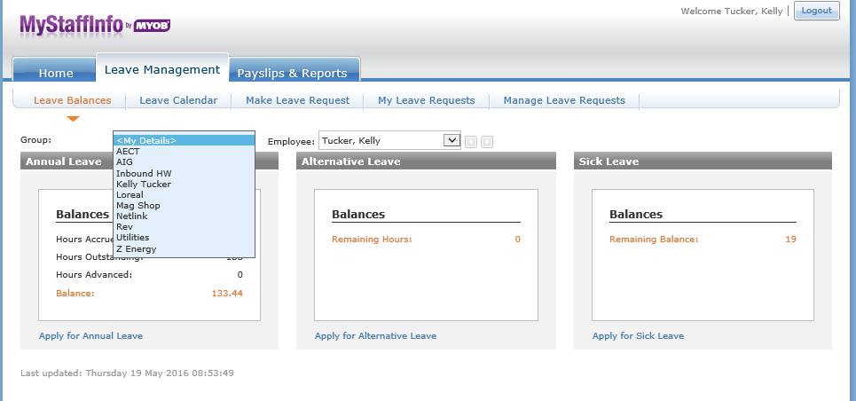
40.00
40.00
80.00
5
80.00
As a Manager you will have group/groups where your Agents fall under
Once you select a group you then have the option of seeing the Agents in that group/groups Leave Balances

Slide 8
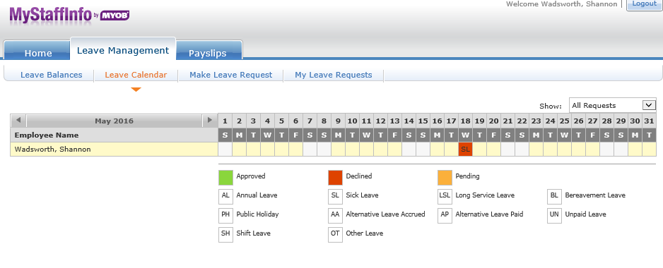
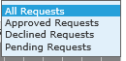
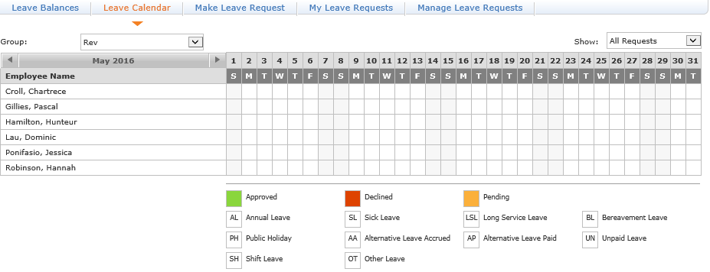
You can change your view depending on what type of request you are after
The Leave Calendar lets the Agent view all their leave requests in calendar format . If you are a manager you can view the leave requests of all your agents as well
Leave will show in this calendar so you can view what agents on leave for the month

Slide 9
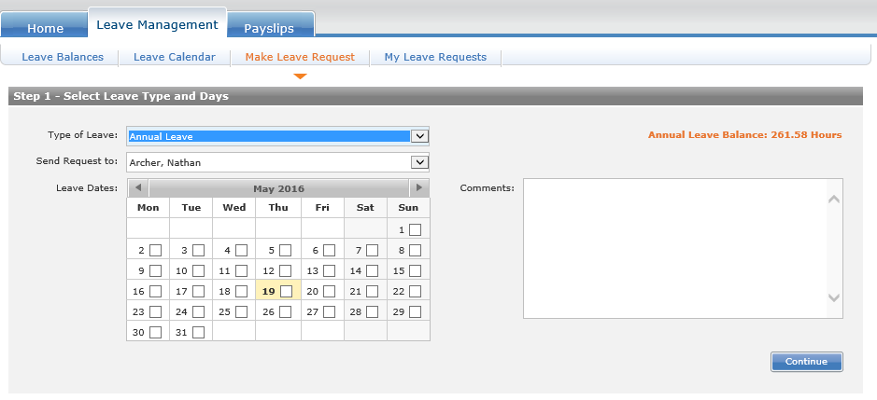
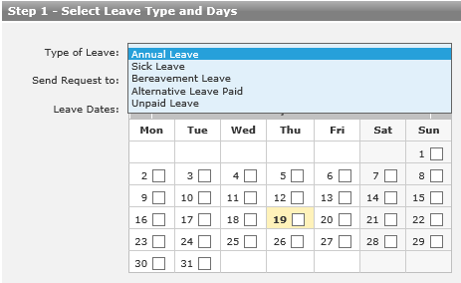
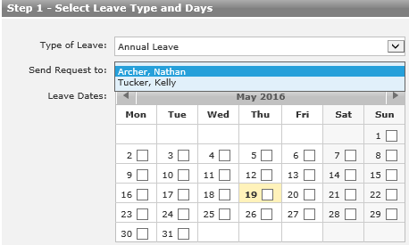
Applying for Leave………..
1.
Select what type of Leave you wish to take
All Agents will have 2 TL available for them to approve Leave (To cover when one TL is away) . They will need to make sure they select the correct TL when applying for leave
Agents can select the days they want off by clicking

Slide 10
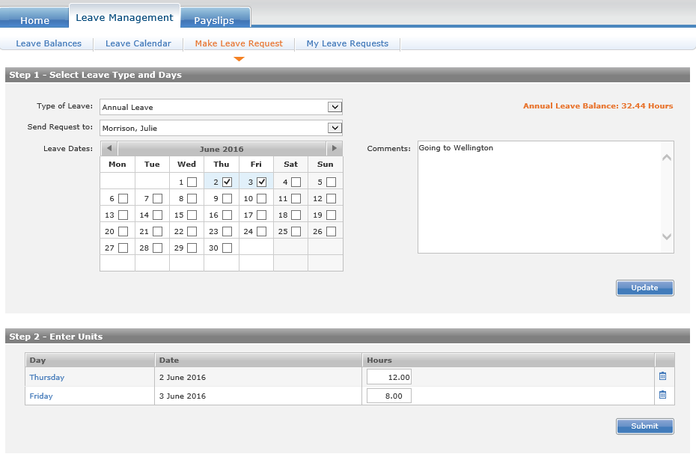
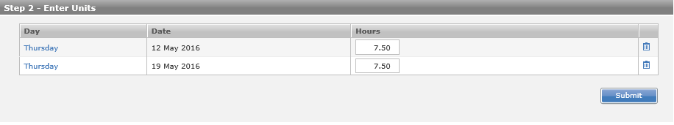
2
Option to add comments on the reason they are taking leave
The option to put the hours in if they are over your standard hours ( If your doing a 12 hour shift )
Once your finished and you have checked you have done everything correctly click “Submit”

Slide 11
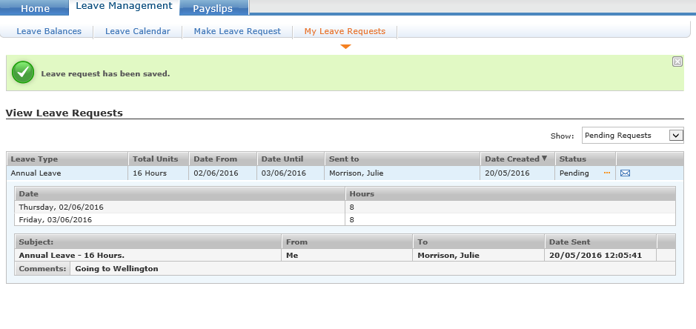
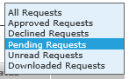
You can filter on which Leave Requests you wish to view
Once the leave request has been sent ,the Manager will receive the below email notifying them the Agent has sent a Leave Request also telling you what company the request is for and the company number
You can click on the hyperlink to take you to the website

Slide 12
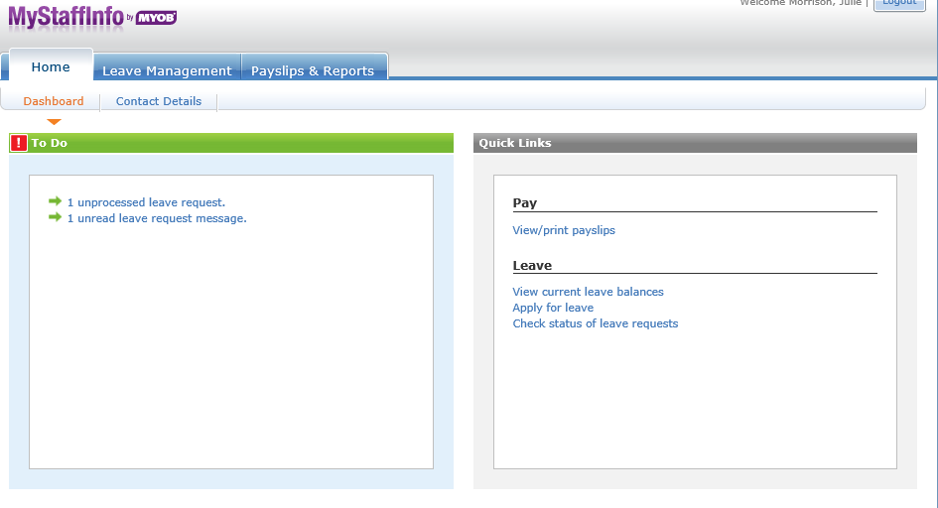
As a Manager when you log in, you will see the following Dashboard showing your unread Leave & Message requests you need to follow up on… These will remain here until they are accepted/declined

Slide 13
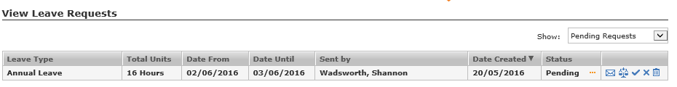
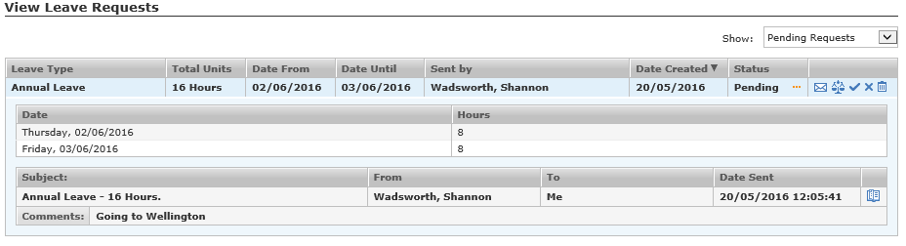
Clicking the link on the dashboard will bring you through to the following . Click the leave request
The scales Icon allows you to view that Agents available leave is
The manager has the choice of messaging back (questioning the leave), approving the leave, declining the leave & deleting the leave request

Slide 14
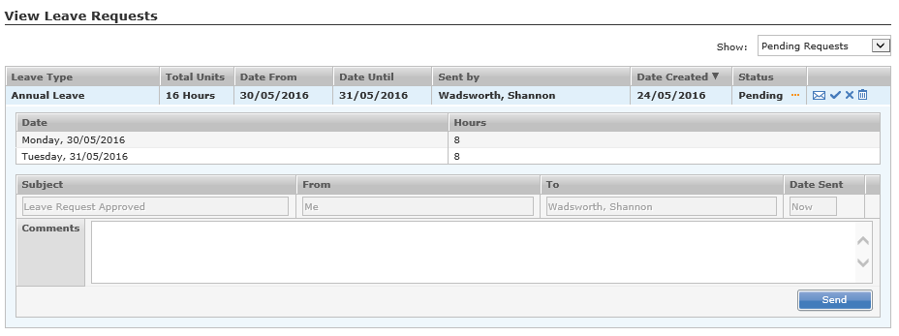
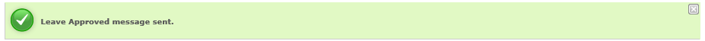
Once you have clicked what option you wish, you then have the option of adding a comment to your leave request, Click Send & the below message will show

Slide 15
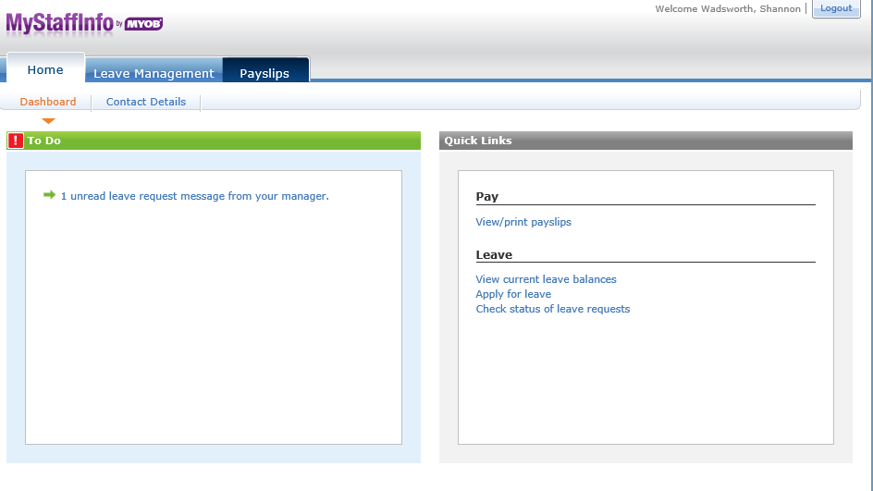
Once the request is approved or declined an email is sent to the agent notifying them
Once the Agent logs in , they will see that there is a leave request message from their Manager. By clicking on the link will take them through to the correct screen

Slide 16
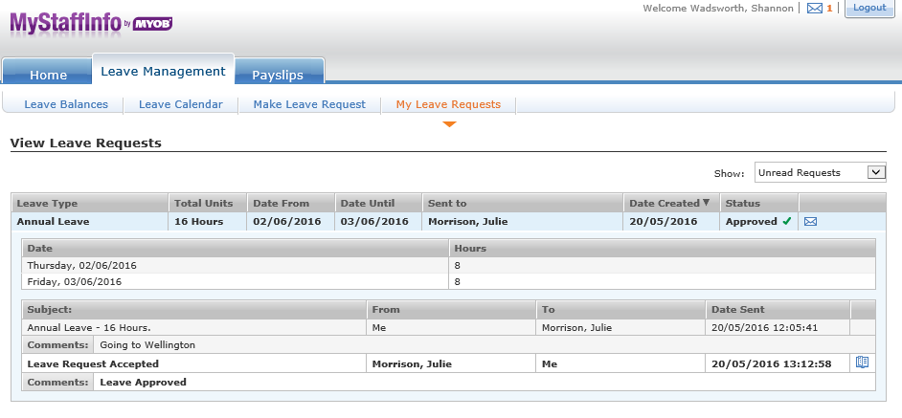
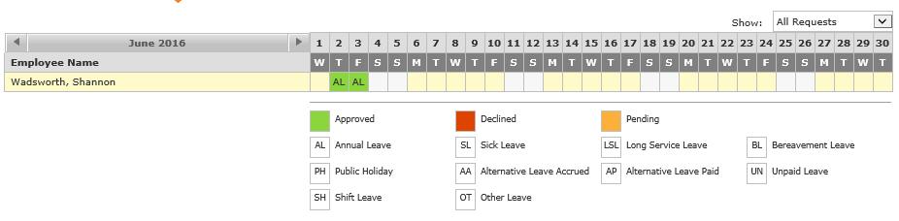
Agent can see that their request is approved or declined
Make sure once you have read the message you click the icon(mark as read) otherwise your dashboard will show you a unread message
The approved or declined leave request will show in the employees leave calendar

Slide 17
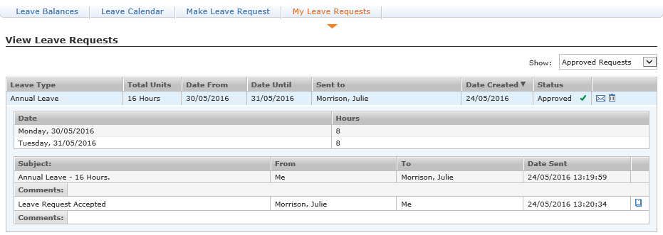
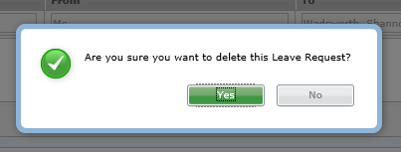
If Agent wants to delete Leave
Click the Trash Bin Icon to delete your leave
Once you delete your leave request, your leave request is also removed from the Managers Calendar

Slide 18
IMPORTANT
Bereavement Leave
-Agents become entitled to Bereavement Leave after 6 months
-When Agents are applying for Bereavement Leave they MUST put in what relation the deceased is to them in the Comment Box
-Bereavement Leave is given in 1 day or 3 days
-1 Day = A death outside of the Immediate Family
-3 Days = Immediate Family. Immediately Family are employees spouse or partner, parent, child, sibling, grandparent, grandchild or the spouses or partners parent
Leave Forms
-If an agent applies for leave within the fortnight period, it is approved and then for what ever reason they need to cancel it & they delete .. It is VERY important that you let Payroll & your TL know
-If for any reason an agent cannot get to a computer to do there leave form , the TL will need to revert back to the paper form

