Slide 1
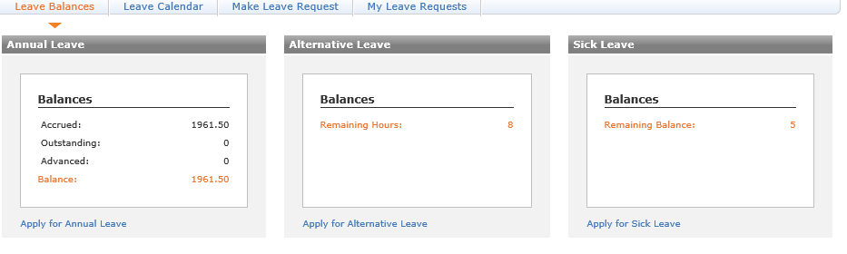
CCP Employees
As CCP Agents are on Casual Contracts , their Annual Leave is displayed in dollar amount
Balance = $1961.50 dollars
For example
Joe Bloggs is paid $17.00 per hour
Balance (1961.50) ÷ Pay Rate ($17.00) = 115.38 hours of Annual Leave
To get there Days amount Annual Leave Hours (115.38) ÷ Standard Hours (8.00) = 14.42 Days
The rest are shown in Hours for Alternative Leave & Days for Sick Leave

Slide 2
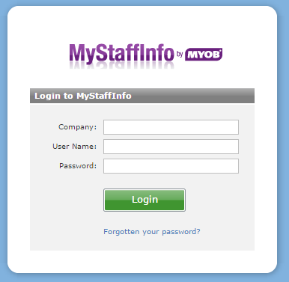
Payroll Users
To approve Leave for a CCP Agent – TL’s are called Payroll Users.
Your Log in details are slightly different to your Telnet Log In
You then approve the Leave Request
Telnet : 219074
CCP: 219072
Username is your email address i.e shannon.wadsworth@telnet.nz
Password – Will be given to you individually

Slide 3
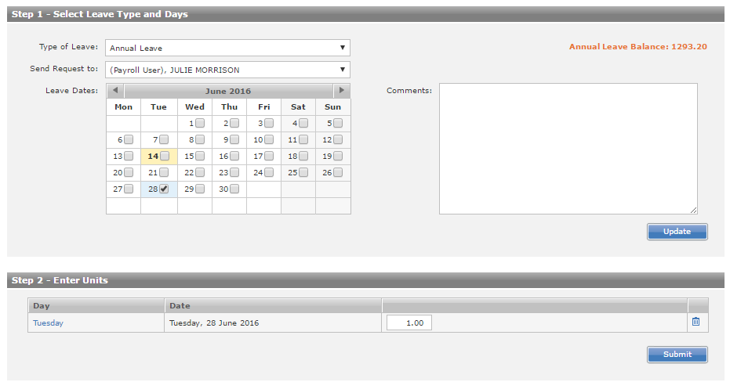
Applying for Leave.... Click on Make Leave Request
Once Leave is submitted to you for approval, the exact same process follows as Telnet.
Just remember there leave is in DAYS not hours
CCP Leave is submitted in Days
1.00 = 1 day
0.50= ½ day

