Slide 1


Slide 2
As an employee you can…………..
Apply for Annual Leave, Alternative Leave, Sick Leave, Bereavement Leave & Unpaid Leave
View and Print Payslips
View Contact Information
View Annual Leave , Alternative Leave & Sick Leave Balances
Delete Leave Requests

Slide 3
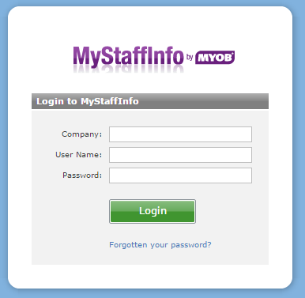
www.mystaffinfo.myob.com
219072
Email address your pay slip is sent to
You can change your password by clicking on the forgotten password link. It will send you an email ( The one you log in with) from there you will click on the link and follow the instructions to change your password
Date of Birth
dd/mm/yyyy

Slide 4
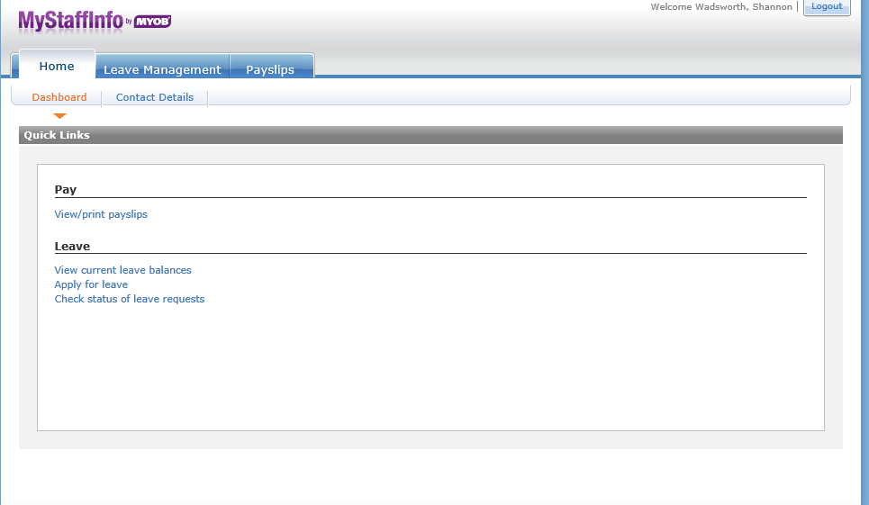
Once you have logged in…….
Quick Links will take you through

Slide 5
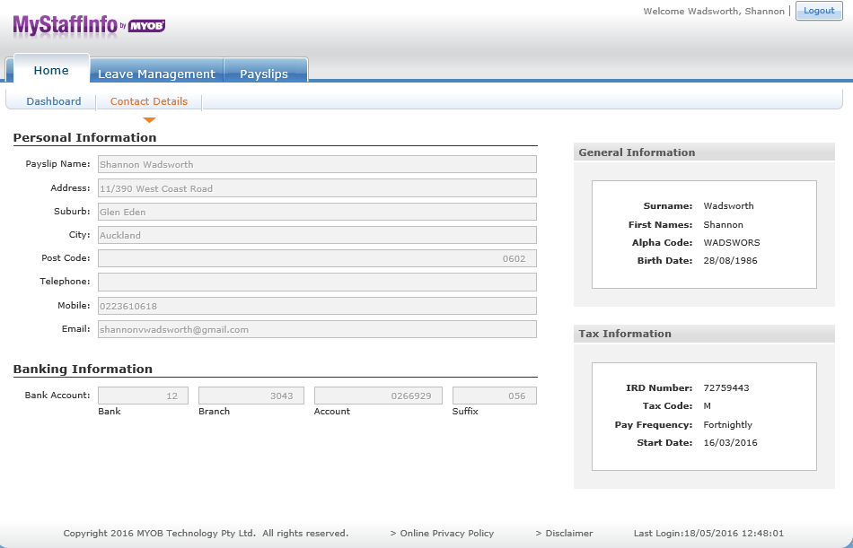
You can view your contact details……………………………………
131 Queen Street
01/03/2025
022 222 2222
shannon.Wadsworth@telnet.nz
555-555-555
You cannot change any details in this screen . This is for you to ensure your details are correct

Slide 6
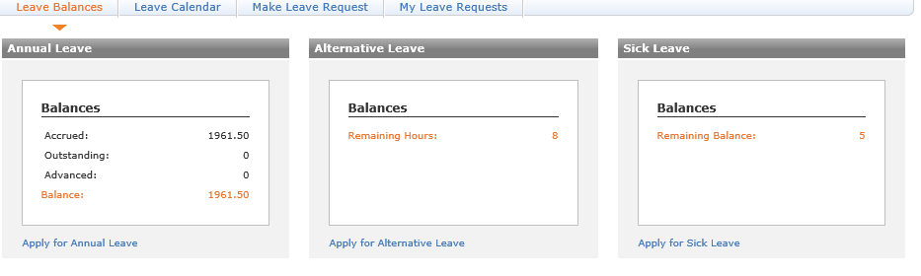
Leave Management is where you can see your Leave Balances, View the Leave Calendar, Make Leave Requests & Delete your Leave Request
As a CCP Agent your on Casual Contracts , your Annual Leave is displayed in dollar amount
Balance = $1961.50 dollars
For example
Joe Bloggs is paid $17.00 per hour
Balance (1961.50) ÷ Pay Rate ($17.00) = 115.38 hours of Annual Leave
To get there Days amount Annual Leave Hours (115.38) ÷ Standard Hours (8.00) = 14.42 Days
The rest are shown in Hours for Alternative Leave & Days for Sick Leave

Slide 7
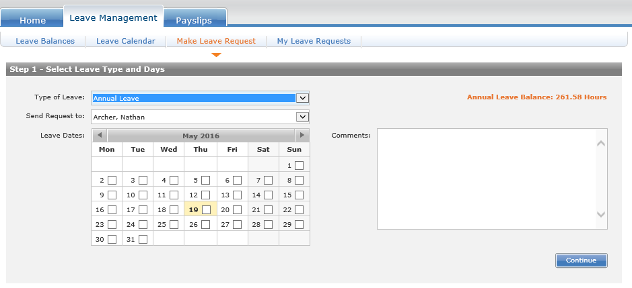
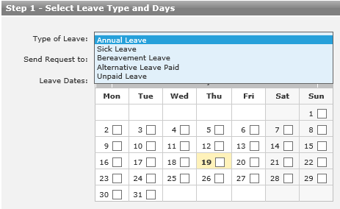
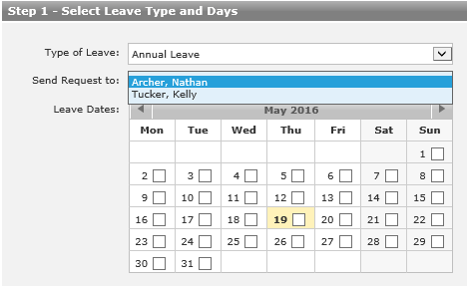
Applying for Leave.... Click on Make Leave Request
Select your TL, you will all have 2 TL’s showing incase one is on leave
Select what type of Leave you wish to take
Select the days they want off by clicking on the date

Slide 8
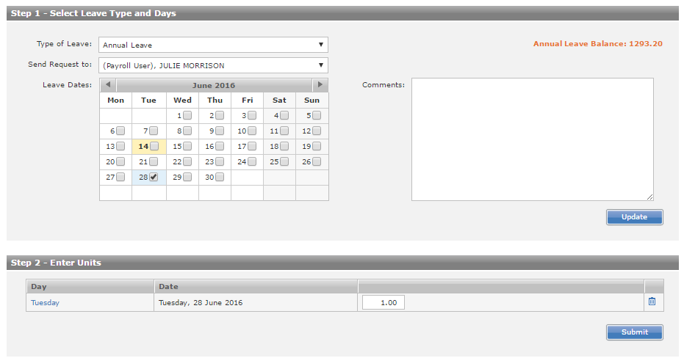
Option to add comments on the reason as to why you are taking leave. Click Update to validate comment
CCP Leave is submitted in Days
1.00 = 1 day
0.50= ½ day
Ensure you do this correctly
Once your finished and you have checked you have done everything correctly click “Submit”

Slide 9
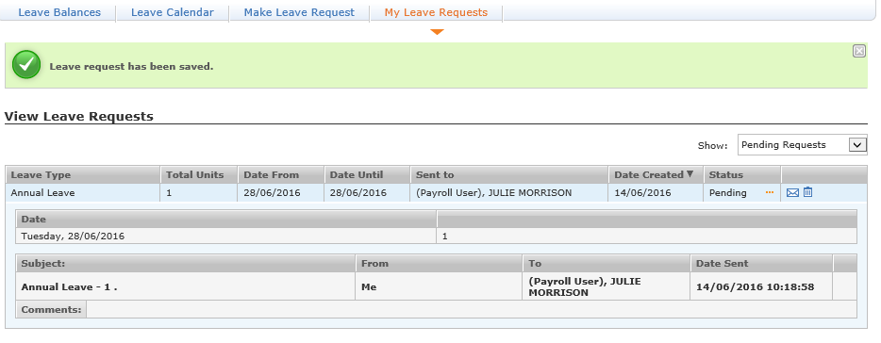
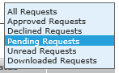
You can filter on which Leave Requests you wish to view
Your Leave Request is then sent to your TL for them to approve/decline your leave, once they have done this you will receive and email like the below
219072
You can click on the hyperlink to take you to the website

Slide 10
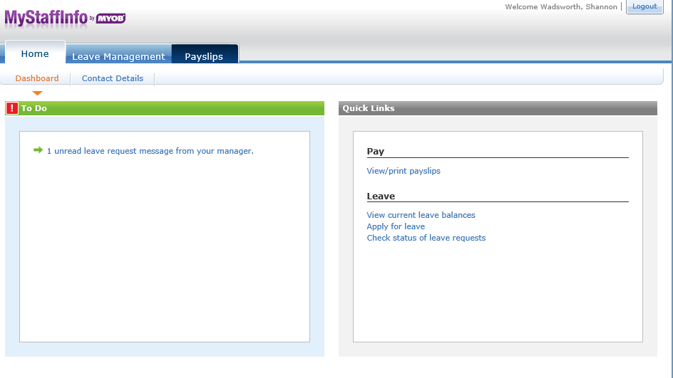
Once you log in you will see the following
By clicking on the link will take them through to the correct screen

Slide 11
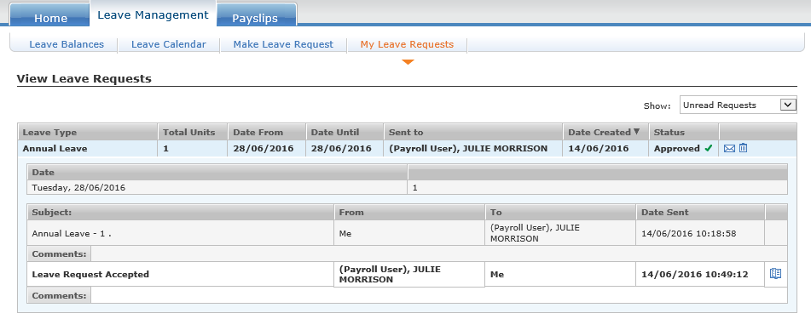
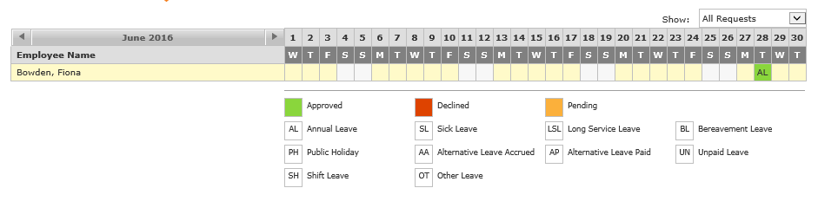
You can see if your Leave has been accepted or declined
Make sure once you have read the message you click the icon(mark as read) otherwise your dashboard will show you a unread message
Joe Bloggs
The approved or declined leave request will show in your calendar and it also show in your TL’s calendar

Slide 12
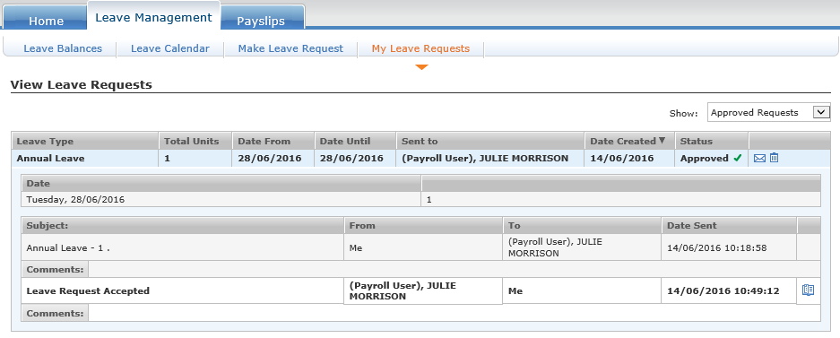
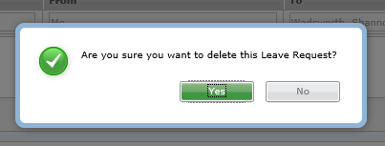
If you want to delete your Leave Request
Click the Trash Bin Icon to delete your leave
Once you delete your leave request, your leave request is also removed from your Managers Calendar

Slide 13
IMPORTANT
Bereavement Leave
You become entitled to Bereavement Leave after 6 months
When you are applying for Bereavement Leave they MUST put in what relation the deceased is to them in the Comment Box
Bereavement Leave is given in 1 day or 3 days
1 Day = A death outside of the Immediate Family
3 Days = Immediate Family. Immediately Family are employees spouse or partner, parent, child, sibling, grandparent, grandchild or the spouses or partners parent

